Slide 1
QM BOT
Documentation

Slide 2
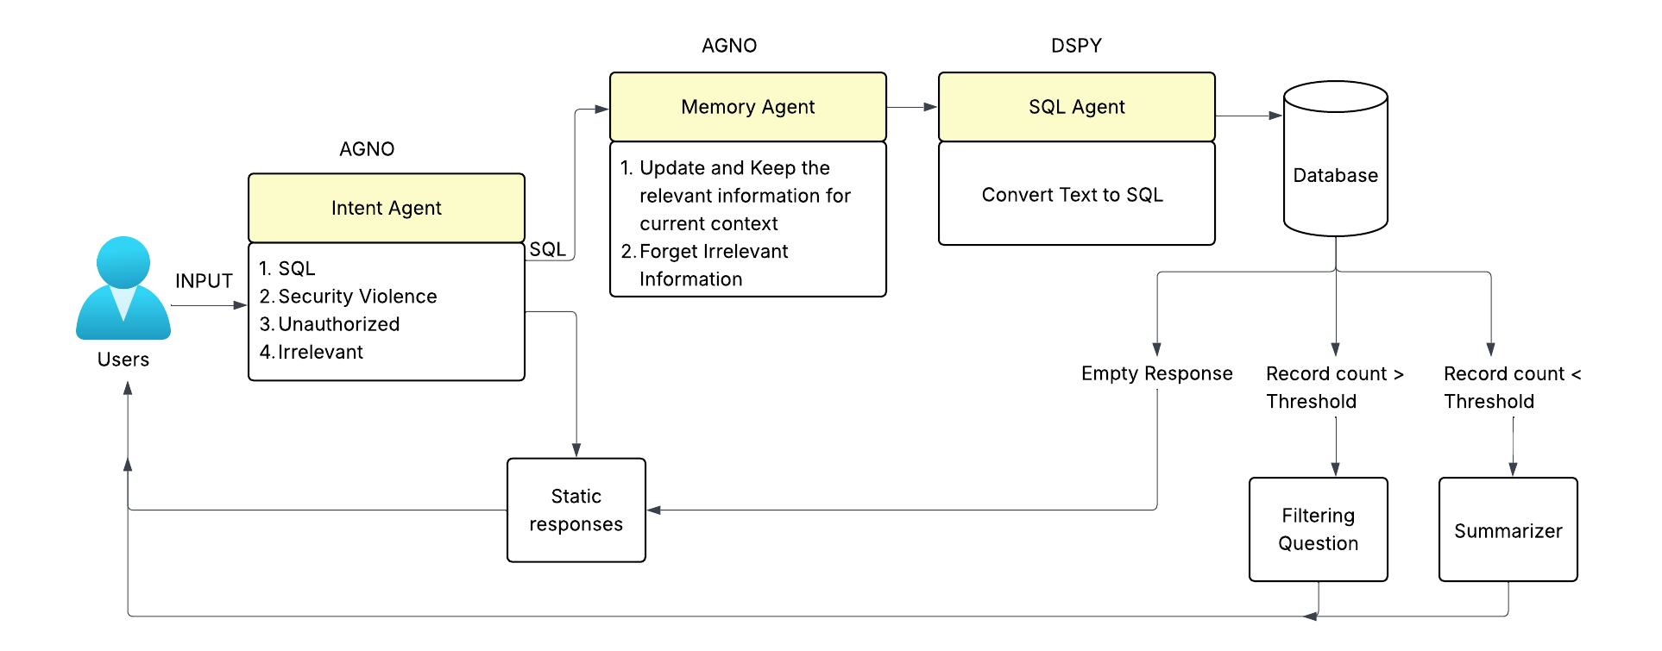
QM BOT - Flow Execution Backend

Slide 3
Framework Comparison - Performance
Documentation : https://www.agno.com/
Feature | LangChain | LangGraph | Agno
Workflow Complexity | Linear/simple chains | Graphs, branching, loops, retries | Declarative, tool-optimized
Ease of Use | Low learning curve, rapid prototyping | Mid–high curve, more setup | Clean API, fast development
Speed & Resource Use | Moderate | Slower, resource-heavy | Ultra‑fast, 50× less memory

Slide 4
Framework Comparison - Features
Feature / Aspect | LangGraph | AGNO
Strengths | - Structured Orchestration with graph-based workflows | - Speed and Efficiency: faster instantiation, lower memory use
 | - Fine-grained Control over interactions and execution paths | - Multimodal Support: text, image, audio, video built-in
 | - Type Safety with statically typed language | - Ease of Use: fewer lines of code, streamlined development
 | - Customization for tailored agents and workflows | - Tool Integration: pre-built tools and integrations
 |  | - Knowledge Management: vector DBs for RAG & dynamic few-shot
Weaknesses | - Steeper Learning Curve | - Accuracy and Reliability under edge cases still developing
 | - Challenges in Production Readiness | - Less Fine-grained Control over agent interactions
 | - Manual Memory Management | - Production Readiness

Slide 5
Reason for choosing Agno for Memory Agent
Documentation : https://langwatch.ai/blog/best-ai-agent-frameworks-in-2025-comparing-langgraph-dspy-crewai-agno-and-more
Framework | Best For | Feature | Advantages
LangGraph | Complex stateful workflows | Functional API + OpenAI compatibility | Doc sprawl + bloated from LangChain layers
DSPy | Optimizable workflows, eval-driven | Results-focused, fast, ReAct-centric | Tool calls are hidden, not OpenAI-style
Agno | Production-grade agentic memory | Great docs, unique abstractions | Needs stringified tool outputs

Slide 6
DSPy For SQL Agent
Declarative Programming Model
Lets you define what the model should do rather than how to do it, simplifying complex prompt engineering and optimization.
Chains, Predictors, Optimizers
Breaks workflows into reusable modules promoting code reuse and clarity.
Automatic Prompt Optimization
Uses techniques like instruction tuning, few-shot selection, and retrieval optimization to automatically improve model performance without manual tweaking.
Performance Tracking:
Allows integration of evaluation metrics and optimization loops directly into the development process.
Community and Stanford Backing
Developed by Stanford researchers with a growing open-source community and real research use cases.

Slide 7
Using DSPy to Overcome AGNO's Limitations
Improving Accuracy & Reliability
DSPy’s automatic prompt optimization and declarative modules help refine prompts and logic under edge cases, increasing output reliability.
You can define testable behavior and expectations using evaluation metrics, which AGNO currently lacks.
Gaining Fine-Grained Control
While AGNO trades control for ease, DSPy allows you to modularize agent behavior with chains and predictors, enabling step-level customization of logic without losing structure.
This bridges AGNO’s simplicity with LangGraph-level control.
Enhancing Production Readiness
DSPy promotes transparent workflows, making it easier to debug, audit, and version agent behavior—key for production deployments.
Built-in tools for evaluation and improvement reduce manual fine-tuning cycles.

Slide 8
Framework Evaluation
Individual Limitations:
LangChain Heavy utilization with lower performance. Its monolithic architecture and runtime overhead can hinder scalability and responsiveness in real-time applications.
Vanna.AI Lacks advanced features. Primarily focused on basic data querying; insufficient for building complex, adaptive agent systems.
DSPy (Standalone) Powerful, but limited in production-grade agent management. While it offers prompt optimization and modular reasoning, it lacks native support for real-time agent orchestration and multimodal tool use.
AGNO (Standalone) Average accuracy with limited control. Prioritizes speed and usability, but at the cost of reliability in edge cases and fine-grained logic tuning.

Slide 9
Approach Used:
DSPy + AGNO Integration → Result-Centric, Agent-Capable Architecture
By combining DSPy's prompt optimization, modular design, and reasoning capabilities with AGNO's speed, multimodal support, and tool integration, we can achieve:
Result-Centric Intelligence: DSPy ensures high-accuracy reasoning and adaptability under varying inputs.
Agent Build Capabilities: AGNO’s lightweight framework enables rapid creation and deployment of multimodal, tool-using agents.
Control + Performance: DSPy injects reliability and precision into AGNO’s fast agent pipeline—achieving both quality and responsiveness.

Slide 10
Refference
Ref :
https://langwatch.ai/blog/best-ai-agent-frameworks-in-2025-comparing-langgraph-dspy-crewai-agno-and-more
https://medium.com/@seahorse.technologies.sl/langchain-vs-langgraph-vs-agno-agents-e3f986727c71
https://sonikamaheshwari005.medium.com/langgraph-langchain-and-agno-84d84065626d
https://getstream.io/blog/multiagent-ai-frameworks/

